Slide 1
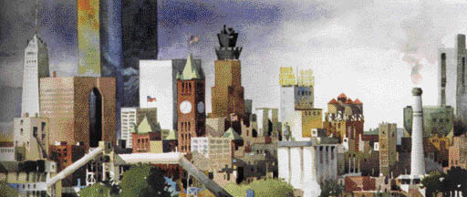

PowerPoint® Lecture Presentation
to accompany
Principles of Economics, Fourth Edition
N. Gregory Mankiw
Prepared by Kathryn Nantz and Laurence Miners, Fairfield University.

Slide 2
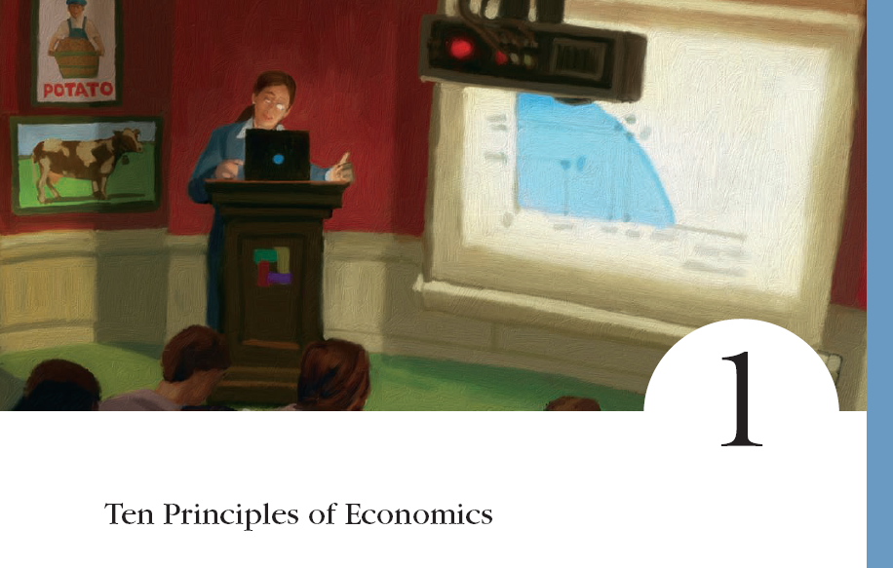
© 2007 Thomson South-Western

Slide 3
Economy. . .
. . . The word economy comes from a Greek word for “one who manages a household.”

Slide 4
TEN PRINCIPLES OF ECONOMICS
A household and an economy face many decisions:
  Who will work?
  What goods and how many of them should be produced?
  What resources should be used in production?
  At what price should the goods be sold?

Slide 5
TEN PRINCIPLES OF ECONOMICS
Society and Scarce Resources:
  The management of society’s resources is important because resources are scarce.
  Scarcity. . . means that society has limited resources and therefore cannot produce all the goods and services people wish to have.

Slide 6
TEN PRINCIPLES OF ECONOMICS
Economics is the study of how society manages its scarce resources.

Slide 7
HOW PEOPLE MAKE DECISIONS
People face trade-offs.
The cost of something is what you give up to get it.
Rational people think at the margin.
People respond to incentives.

Slide 8

Principle #1: People Face Trade-offs.
“There is no such thing as a free lunch!”

Slide 9
Principle #1: People Face Trade-offs.
To get one thing, we usually have to give up another thing.
  Guns v. butter
  Food v. clothing
  Leisure time v. work
  Efficiency v. equity
Making decisions requires trading
off one goal against another.

Slide 10
Principle #1: People Face Trade-offs
Efficiency v. Equity
  Efficiency means society gets the most that it can from its scarce resources.
  Equity means the benefits of those resources are distributed fairly among the members of society.
Notes:
9

Slide 11
Principle #2: The Cost of Something Is What You Give Up to Get It.
Decisions require comparing costs and benefits of alternatives.
  Whether to go to college or to work?
  Whether to study or go out on a date?
  Whether to go to class or sleep in?
The opportunity cost of an item is what you give up to obtain that item.
Notes:
10

Slide 12


Principle #2: The Cost of Something Is What You Give Up to Get It.
Basketball star LeBron James understands opportunity costs and incentives. He chose to skip college and go straight from high school to the pros where he earns millions of dollars.
Notes:
10

Slide 13
Principle #3: Rational People Think at the Margin.
Marginal changes are small, incremental adjustments to an existing plan of action.
People make decisions by comparing costs and benefits at the margin.
Notes:
11

Slide 14
Principle #4: People Respond to Incentives.
Marginal changes in costs or benefits motivate people to respond.
The decision to choose one alternative over another occurs when that alternative’s marginal benefits exceed its marginal costs!
Notes:
12

Slide 15
HOW PEOPLE INTERACT
Trade can make everyone better off.
Markets are usually a good way to organize economic activity.
Governments can sometimes improve economic outcomes.

Slide 16
Principle #5: Trade Can Make Everyone Better Off.
People gain from their ability to trade with one another.
Competition results in gains from trading.
Trade allows people to specialize in what they do best.
Notes:
15

Slide 17
Principle #6: Markets Are Usually a Good Way to Organize Economic Activity.
A market economy is an economy that allocates resources through the decentralized decisions of many firms and households as they interact in markets for goods and services.
  Households decide what to buy and who to work for.
  Firms decide who to hire and what to produce.
Notes:
16

Slide 18
Principle #6: Markets Are Usually a Good Way to Organize Economic Activity.
Adam Smith made the observation that households and firms interacting in markets act as if guided by an “invisible hand.”
  Because households and firms look at prices when deciding what to buy and sell, they unknowingly take into account the social costs of their actions.
  As a result, prices guide decision makers to reach outcomes that tend to maximize the welfare of society as a whole.
Notes:
16

Slide 19
Principle #7: Governments Can Sometimes Improve Market Outcomes.
Markets work only if property rights are enforced.
  Property rights are the ability of an individual to own and exercise control over a scarce resource
Market failure occurs when the market fails to allocate resources efficiently.
When the market fails (breaks down) government can intervene to promote efficiency and equity.
Notes:
17

Slide 20
Principle #7: Governments Can Sometimes Improve Market Outcomes.
Market failure may be caused by:
  an externality, which is the impact of one person or firm’s actions on the well-being of a bystander.
  market power, which is the ability of a single person or firm to unduly influence market prices.
Notes:
18

Slide 21
HOW THE ECONOMY AS A WHOLE WORKS
A country’s standard of living depends on its ability to produce goods and services.
Prices rise when the government prints too much money.
Society faces a short-run trade-off between inflation and unemployment.

Slide 22
Principle #8: A Country’s Standard of Living Depends on Its Ability to Produce Goods and Services.
Standard of living may be measured in different ways:
  By comparing personal incomes.
  By comparing the total market value of a nation’s production.
Notes:
21

Slide 23
Principle #8: A Country’s Standard of Living Depends on Its Ability to Produce Goods and Services.
Almost all variations in living standards are explained by differences in countries’ productivities.
Productivity is the amount of goods and services produced from each hour of a worker’s time.
Notes:
21

Slide 24
Principle #8: A Country’s Standard of Living Depends on Its Ability to Produce Goods and Services.
Standard of living may be measured in different ways:
  By comparing personal incomes.
  By comparing the total market value of a nation’s production.
Notes:
21

Slide 25
Principle #9: Prices Rise When the Government Prints Too Much Money.
Inflation is an increase in the overall level of prices in the economy.
One cause of inflation is the growth in the quantity of money.
When the government creates large quantities of money, the value of the money falls.
Notes:
23

Slide 26
Principle #10: Society Faces a Short-run Trade-off between Inflation and Unemployment.
The Phillips Curve illustrates the trade-off between inflation and unemployment:
  Inflation or Unemployment
    It’s a short-run trade-off!
  The trade-off plays a key role in the analysis of the business cycle—fluctuations in economic activity, such as employment and production
Notes:
23

Slide 27
The principles of personal decision making are:
  People face trade-offs.
  The cost of something is what you give up to get it.
  Rational people think at the margin.
  People respond to incentives.

Slide 28
The principles of economic interaction are:
  Trade can make everyone better off.
  Markets are usually a good way to organize economic activity.
  Governments can sometimes improve market outcomes.

Slide 29
The principles of the economy as a whole are:
  A country’s standard of living depends on its ability to produce goods and services.
  Prices rise when the government prints too much money.
  Society faces a short-run trade-off between inflation and unemployment.

